Slide 1
LearnMate: AI-Powered Personalized Learning Coach
IBM INTERNSHIP PROJECT
Presented By:
Student name : GAYATRI SANJEEV MAHAJAN
College Name : TERNA ENGINEERING COLLEGE
Department : COMPUTER ENGINEERING

Slide 2
OUTLINE
Problem Statement
Technology used
Wow factor
End users
Result
Conclusion
Git-hub Link
Future scope
IBM Certifications

Slide 3
Problem Statement
Students struggle to find the right online courses because there are too many options and no personalized guidance. Without proper direction, they often choose mismatched content, waste time, and lose motivation. This leads to frustration and high dropout rates in online learning
Proposed Solution: LearnMate is an AI coach that creates personalized learning paths by analyzing students' goals and skills. It recommends the best courses, tracks progress, and adjusts recommendations automatically. Powered by IBM's AI and cloud technology, it simplifies course selection while improving learning outcomes. The system cuts through information overload to deliver tailored education guidance at scale.

Slide 4
Technology used
IBM cloud lite services
Natural Language Processing (NLP)
Retrieval Augmented Generation (RAG)
IBM Granite model

Slide 5
IBM cloud services used
IBM Cloud Watsonx AI Studio
IBM Cloud Watsonx AI runtime
IBM Cloud Agent Lab
IBM Granite foundation model

Slide 6
Wow factors
LearnMate doesn't just recommend courses—it evolves with you. Powered by IBM's cutting-edge AI, it acts like a personal tutor that remembers every lesson, adjusts to your pace, and anticipates your next skill gap. This isn't static guidance—it's education that grows as you do.
Unique features:
Dynamic Adaptation - Roadmaps automatically reshape based on your progress and feedback
Conversational Intelligence - Natural dialogue assessments (no tedious quizzes)
Cross-Platform Magic - Unifies courses from all major providers into one perfect path
Progress GPS - Visualizes exactly how each course moves you toward goals
IBM-Powered Trust - Enterprise-grade AI with academic rigor (not just another chatbot)

Slide 7
End users
Students & Lifelong Learners
Career Switchers
Educators & Coaches
Corporate L&D Teams
Online Course Providers

Slide 8
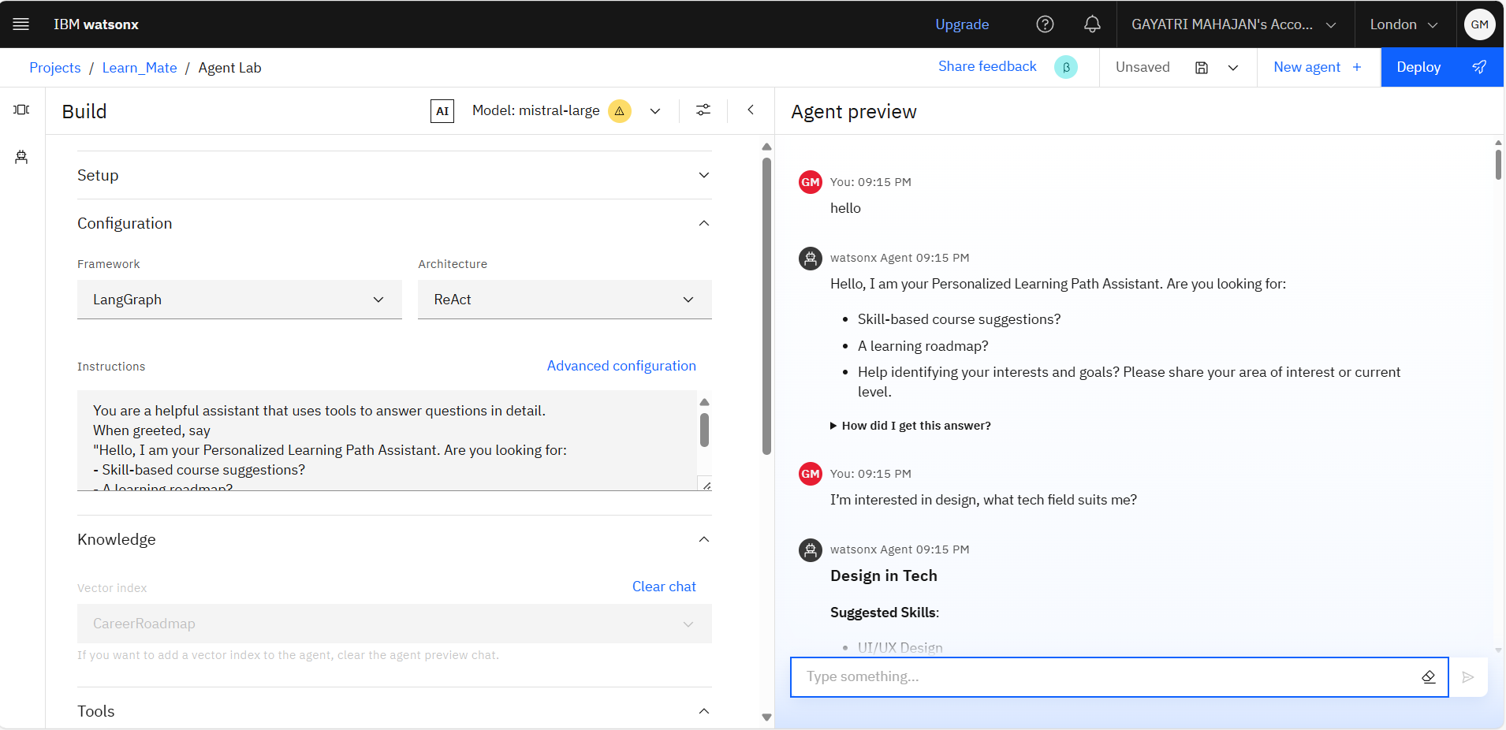
Results

Slide 9
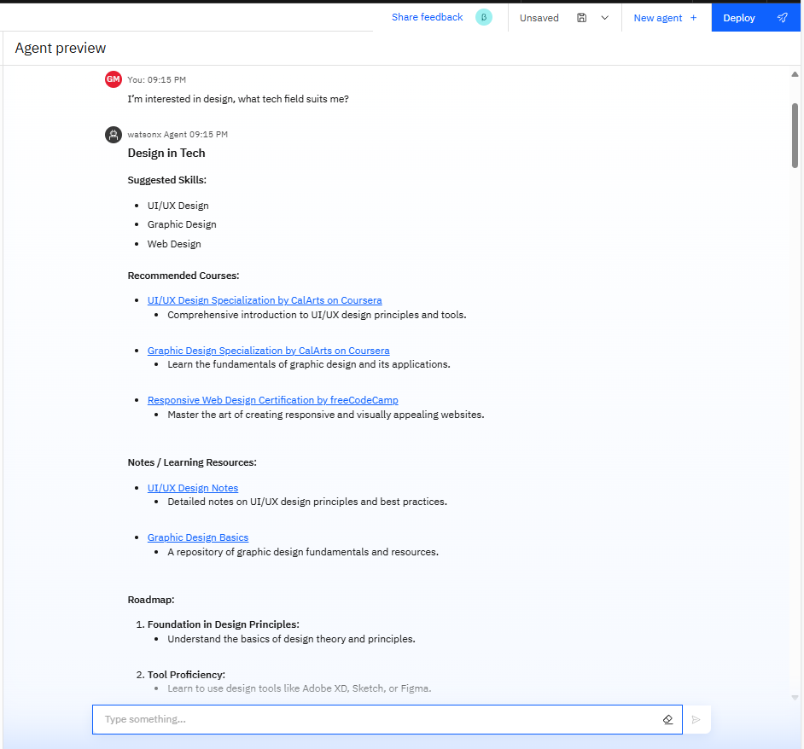
Results

Slide 10
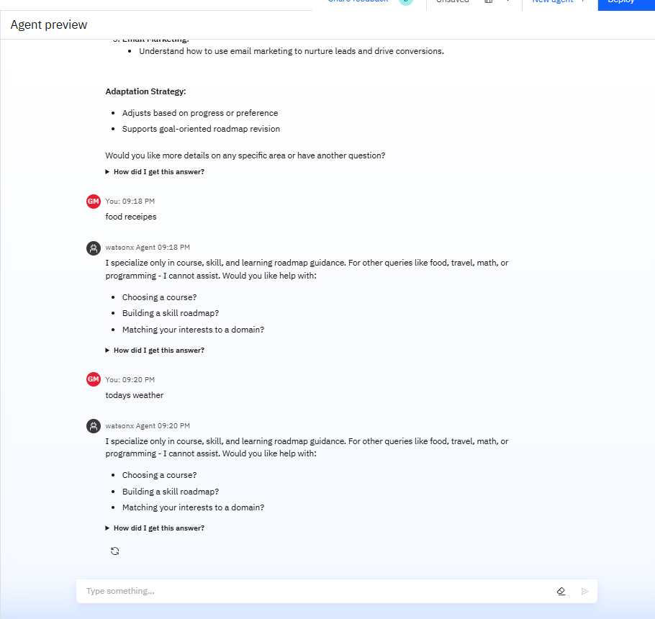
Results

Slide 11
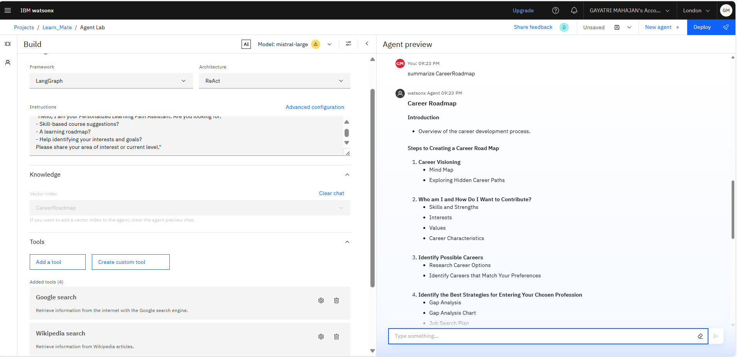
Results

Slide 12
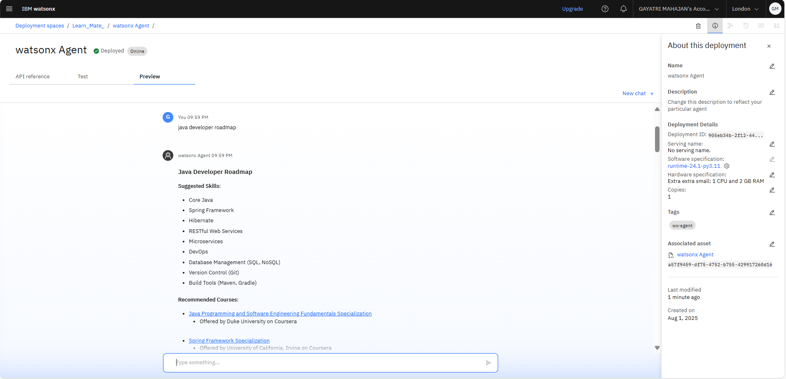
Results
Deployed AI Agent

Slide 13
Conclusion
Solves Choice Overload - Transforms chaotic course catalogs into clear learning paths
AI-Powered Personalization - Delivers human-like guidance at scale via IBM's Granite AI
Future-Ready - Scalable foundation for lifelong learning adaptation
Universal Access - Free-tier IBM Cloud Lite makes personalized education available to all

Slide 14
GitHub Link
Git hub link : https://github.com/Gayatrii0911/learnmate-ai

Slide 15
Future scope
Multilingual Support – Expand to non-English learners with IBM Watson Language Translator
VR Skill Labs – Integrate immersive practice environments for hands-on fields
Corporate API Suite – Plug-and-play upskilling modules for enterprise HR systems
AI Tutor Add-on – Granite-powered Q&A for course-specific doubts
Credential Wallet – Blockchain-based skill certification tracking
Learning Community – Peer matching for collaborative projects
Predictive Analytics – Early dropout risk detection with IBM SPSS

Slide 16
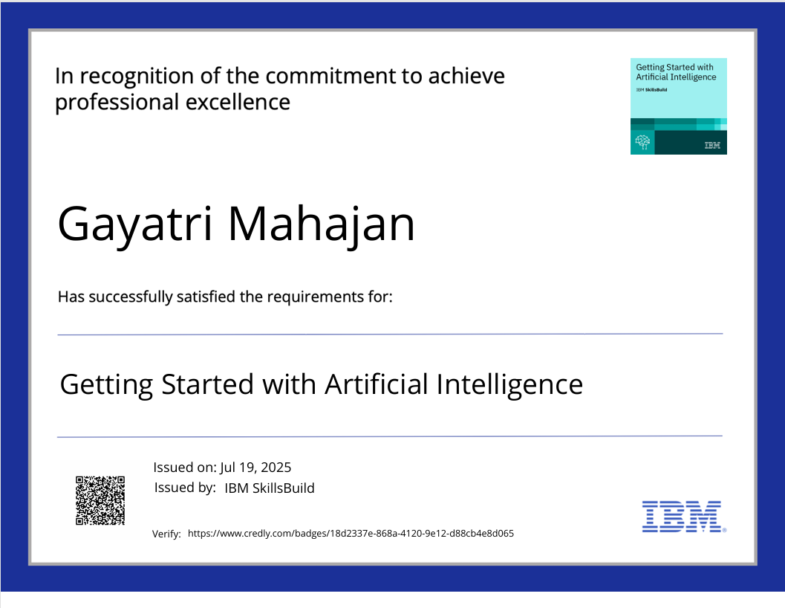
IBM Certifications

Slide 17
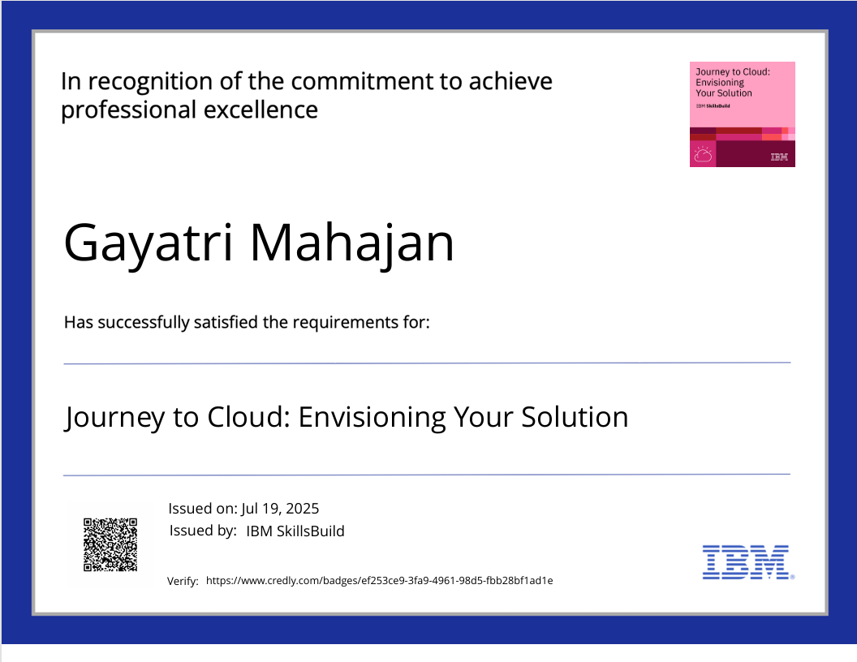
IBM Certifications

Slide 18
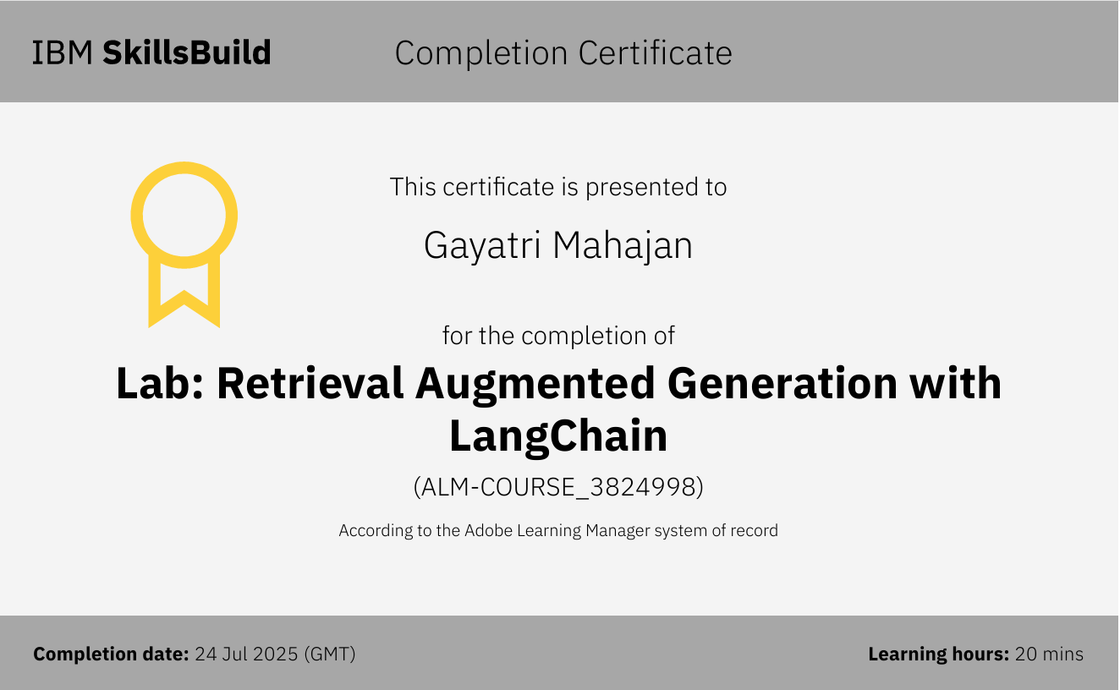

Slide 19
THANK YOU

